Slide 1
Unit 24
The Template Method Pattern
Design Patterns
Notes:
Presentation
D3 - undergraduate

Slide 2
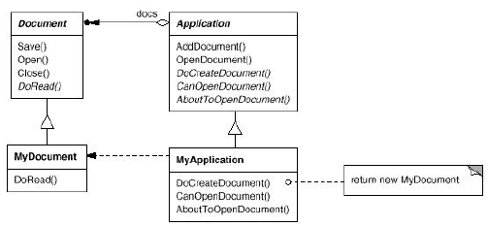
The Template Method Pattern
Intent
  Define the skeleton of an algorithm in an operation, deferring some steps to subclasses. Template Method lets subclasses redefine certain steps of an algorithm without changing the algorithm's structure.
Motivation
  Sometimes you want to specify the order of operations that a method uses, but allow subclasses to provide their own implementations of some of these operations
  Consider:

Slide 3
The Template Method Pattern
Motivation
  The OpenDocument() method might look like this:
  public void OpenDocument (String name) {
    if (!CanOpenDocument(name)) { return; }
      Document doc = DoCreateDocument();
      if (doc !!= null) {
      docs.AddDocument(doc);
      AboutToOpenDocument(doc);
      doc.Open();
      doc.DoRead();
    }
  }
  The OpenDocument() method is a Template Method
  The template method fixes the order of operations, but allows Application subclasses to vary those steps as needed
Notes:
Less cluttered diagrams
Reminder

Slide 4
Template Method Pattern Example 1
Suppose you had a PlainTextDocument class as follows:
  public class PlainTextDocument {
    ...
    public void printPage (Page page) {
      printPlainTextHeader(); // Unique to PlainTextDocument
      System.out.println(page.body());
      printPlainTextFooter(); // Unique to PlainTextDocument
    }
    ...
  }
Notes:
OH with complete chart
Zimmer’s Gamma and Gamma’s Gamma not the same

Slide 5
Template Method Pattern Example 1(Continued)
And then you wrote an HtmlTextDocument class like this:
  public class HtmlTextDocument {
    ...
    public void printPage (Page page) {
      printHtmlTextHeader(); // Unique to HtmlTextDocument
      System.out.println(page.body());
      printHtmlTextFooter(); // Unique to HtmlTextDocument
    }
    ...
  }

Slide 6
Template Method Pattern Example 1(Continued)
The printPage() methods in the PlainTextDocument and HtmlTextDocument classes look much alike
Whenever we see two such similar methods in subclasses, it makes sense to bring the methods together into a uperclass method
We can write a printPage() template method in a superclass that allows for PlainTextDocument and HtmlTextDocument to provide their unique implementations of abstract methods to print the header and footer

Slide 7
Template Method Pattern Example 1(Continued)
Here is the TextDocument superclass:
  public abstract class TextDocument {
    ...
    public final void printPage (Page page) {
      printTextHeader();
      printTextBody(page);
      printTextFooter();
    }
    public abstract void printTextHeader();
    public final void printTextBody(Page page) {
      System.out.println(page.body());
    }
    public abstract void printTextFooter();
    ...
  }
Notes:
Combine last two slides

Slide 8
Template Method Pattern Example 1(Continued)
And here is the new PlainTextDocument class (the new HtmlTextDocument class is similar):
  public class PlainTextDocument extends TextDocument {
    ...
    public void printTextHeader () {
      // Code for header plain text header here.
    }
    public void printTextFooter () {
      // Code for header plain text footer here.
    }
    ...
  }
Note that all we have to do is provide the proper implementations of the abstract methods in the TextDocument superclass
Notes:
Uses, combine, similar
Strategy – flyweight: both stateless
OH with complete chart

Slide 9
The Template Method Pattern
Applicability
Use the Template Method pattern:
  To implement the invariant parts of an algorithm once and leave it up to subclasses to implement the behavior that can vary
  To localize common behavior among subclasses and place it in a common class (in this case, a superclass) to avoid code duplication. This is a classic example of ”code refactoring.”
  To control how subclasses extend superclass operations. You can define a template method that calls "hook" operations at specific points, thereby permitting extensions only at those points.
The Template Method is a fundamental technique for code reuse.
Notes:
Zimmer’s idéa

Slide 10
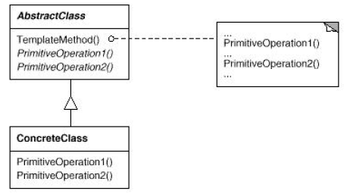
The Template Method Pattern
Structure
Notes:
Very general
Used in a lot of other patterns
Applicability
Participants
Collaborations

Slide 11
The Template Method Pattern
Implementation Issues
  Operations which must be overridden by a subclass should be made abstract
  If the template method itself should not be overridden by a subclass, it should be made final
  To allow a subclass to insert code at a specific spot in the operation of the algorithm, insert “hook” operations into the template method. These hook operations may do nothing by default.
  Try to minimize the number of operations that a subclass must override, otherwise using the template method becomes tedious for the developer
  In a template method, the parent class calls the operations of a subclass and not the other way around. This is an inverted control structure that's sometimes referred to as "the Hollywood principle," as in, "Don't call us,we'll call you".
Notes:
Better organization
Arrows form acyclig graph

Slide 12
Template Method Pattern Example 2
Suppose we have a Manufacturing class as follows:
  public class Manufacturing {
    ...
    // A template method!
    public final void makePart () {
      operation1();
      operation2();
    }
    public void operation1() {
      // Default behavior for Operation 1
    }
    public void operation2() {
      // Default behavior for Operation 2
    }
    ...
  }

Slide 13
Template Method Pattern Example 2 (Continued)
And a subclass wants to do some behavior between operation1() and operation2() of makePart(), so it overrides operation2() as follows:
  public class MyManufacturing {
    ...
    // We want to do behavior between operation1() and
    // operation2() of makePart(), so we override operation2()
    // as follows. (Note: we could just as easily have
    // overridden operation1().)
    public void operation2() {
      // Put behavior we want to do BEFORE the normal Operation2
      // here!
      super.operation2();
    }
    ...
  }

Slide 14
Template Method Pattern Example 2 (Continued)
If you find that many subclasses want to do this, it is wise to modify the superclass and put in a hook operation:
  public class Manufacturing {
  ...
  // A template method!
  public final void makePart () {
    operation1();
    hook(); // A hook method
    operation2();
  }
  // Do nothing hook method.
  public void hook() {}
    ...
  }
Now subclasses only need to provide an implementation for the hook() method

Slide 15
Conclusion
Template

